Slide 1
Kubernetes
Signature
Project
by: Ying He

Slide 2
Table of Contents
Introduction
Implementation
Test
References

Slide 3
Introduction
Pod 1: student information records
The Node.js server that returns a student’s grade when given student ID
Pod 2: bookstore
A bookshelf application using Python Flask framework & REAST API

Slide 4

Implementation
Create a cluster on GKE
gcloud container clusters create kubia --num-nodes=1 --machine-type=e2-micro --region=us-west1
Create a Persistent Volume
gcloud compute disks create --size=10GiB --zone=us-west1-a mongodb

Slide 5
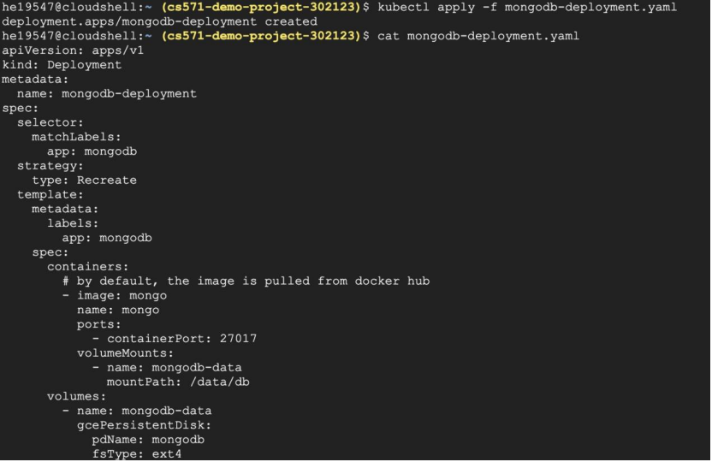
Implementation
Create a mongodb deployment with yaml file

Slide 6
Implementation
Check pods and start running

Slide 7
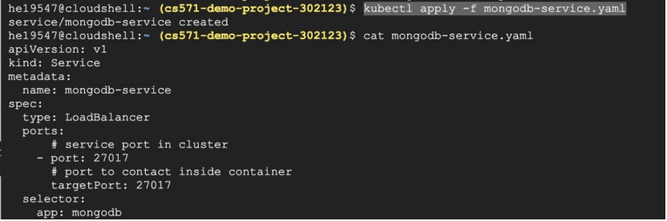
Implementation
create mongodb-service.yaml

Slide 8
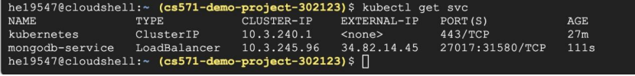
Implementation
Check the service(the external-ip is needed )
Check mongodb
kubectl exec -it mongodb-deployment-replace-with-your-pod-name -- bash

Slide 9
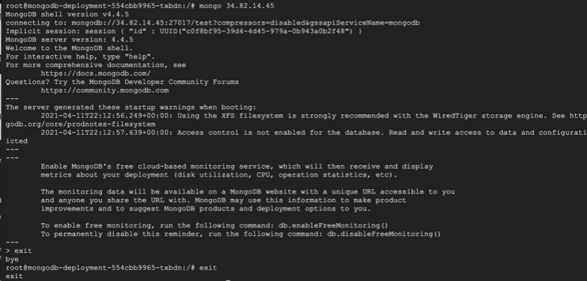
Implementation
Mongo External-ip and how to exit

Slide 10
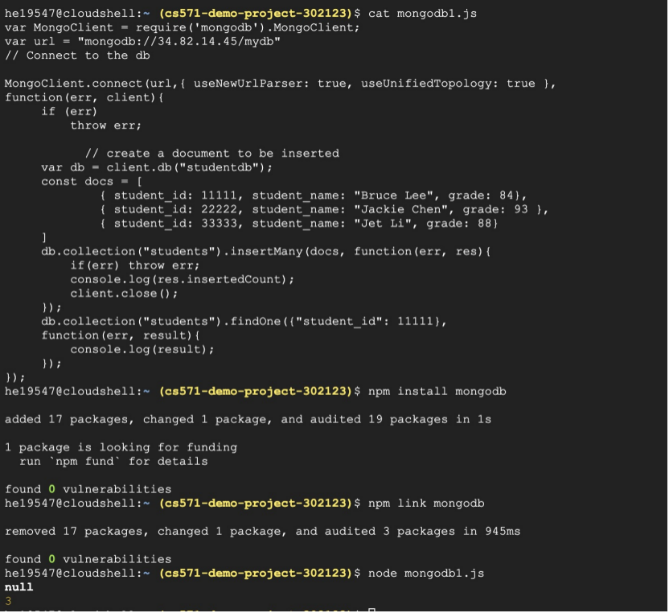
Implementation
insert records in to mongoDB

Slide 11
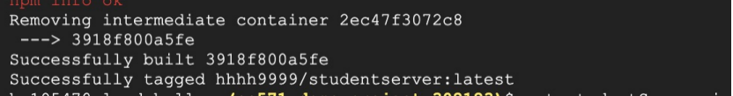
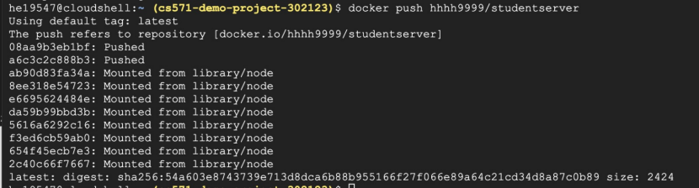
Implementation
Build a docker file for server app and Python Bookshelf REAST API

Slide 12
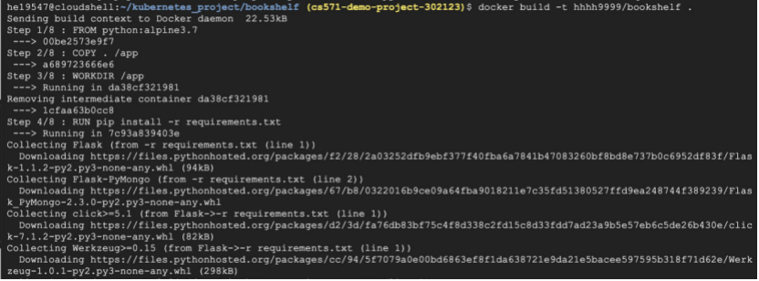
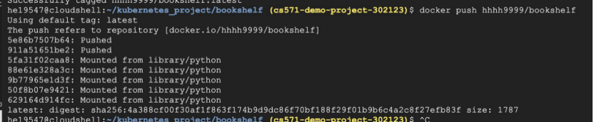

Slide 13
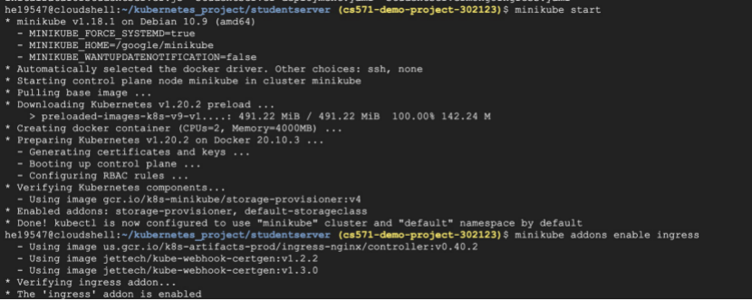
Implementation
Start Minikube and enable ingress for Kubernetes

Slide 14
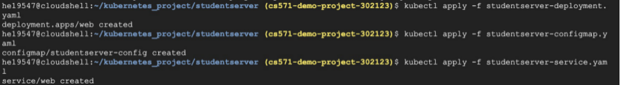

Implementation
Apply nodejs server and bookshelf to Kubernetes pods

Slide 15
Implementation
Create ingress service for both and make sure Ingress service is running and ip address needed
Add ip address to /etc/hosts

Slide 16
Test

Slide 17
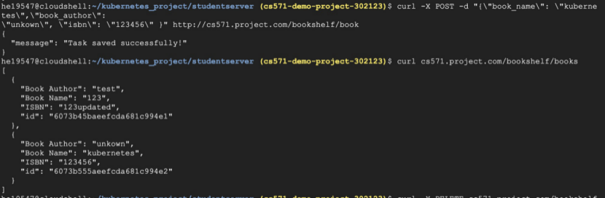
Test
Add book and get all books

Slide 18
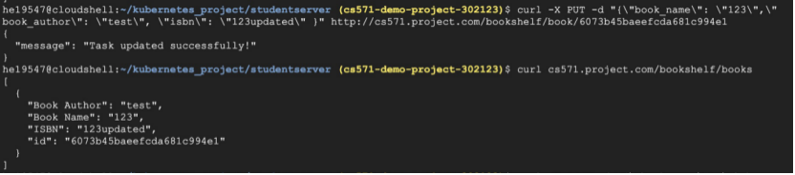
Test
Update book and get all books

Slide 19
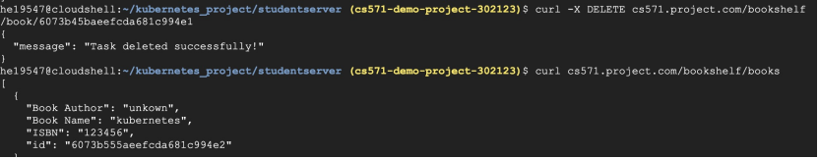
Test
Delet a book and get all books

Slide 20
Reference
https://npu85.npu.edu/~henry/npu/classes/flask_web_development/api/slide/index_slide.html
https://npu85.npu.edu/~henry/npu/classes/cloud_computing/mongodb/slide/index_slide.html

